Slide 1
Simulating Rocket Trajectories Using Thrust Profiles
DATA 440 Project
Dev Saxena

Slide 2
Project Outline
Simulate the launch of a rocket by graphing its altitude and velocity, and noting important parameters such as apogee, fuel burn rate, and other valuable simulation results
Currently testing for small-scale model rockets but could be scaled up for large-rocket simulations
Aim is to optimize for efficiency so that simulations could be used for real-time systems

Slide 3
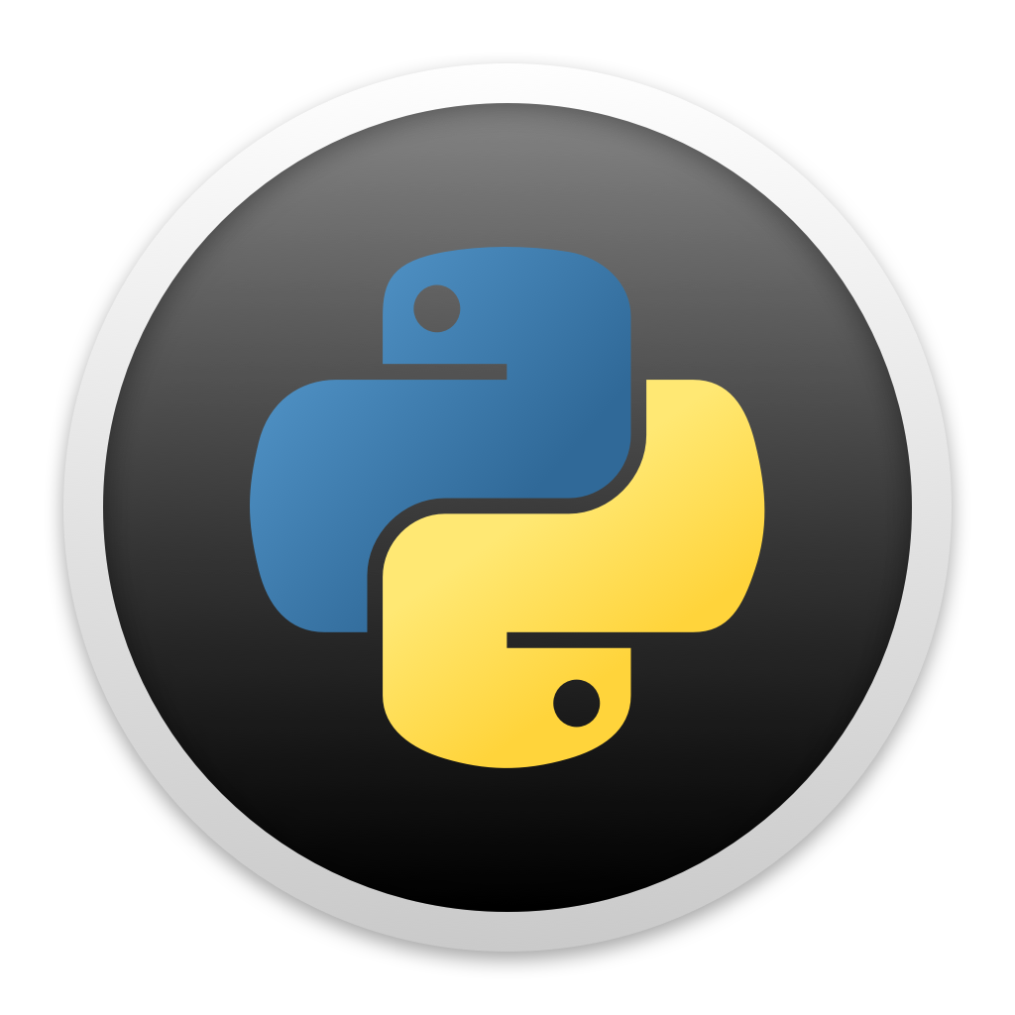
Workflow
User Input
Output
Rocket Parameters
Rocket Mass
Engine Thrust
Fuel Mass
Cross-Sectional Area of Rocket Nose
Simulation Parameters
Step Size (dt)
Precision
Output
Altitude
Velocity
Apogee
Simulate

Slide 4
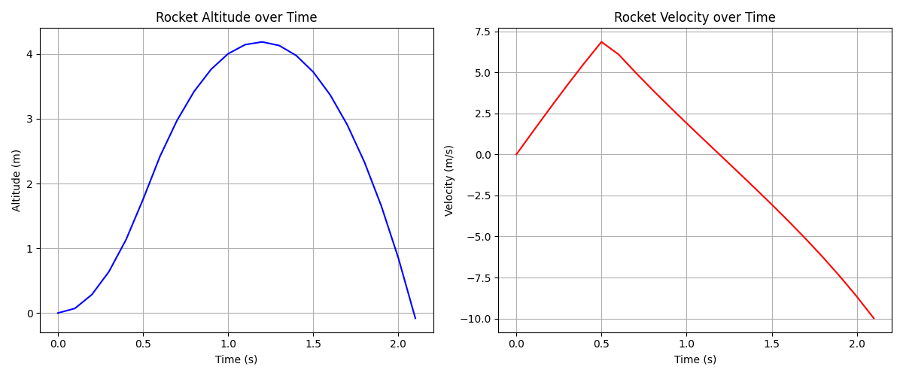
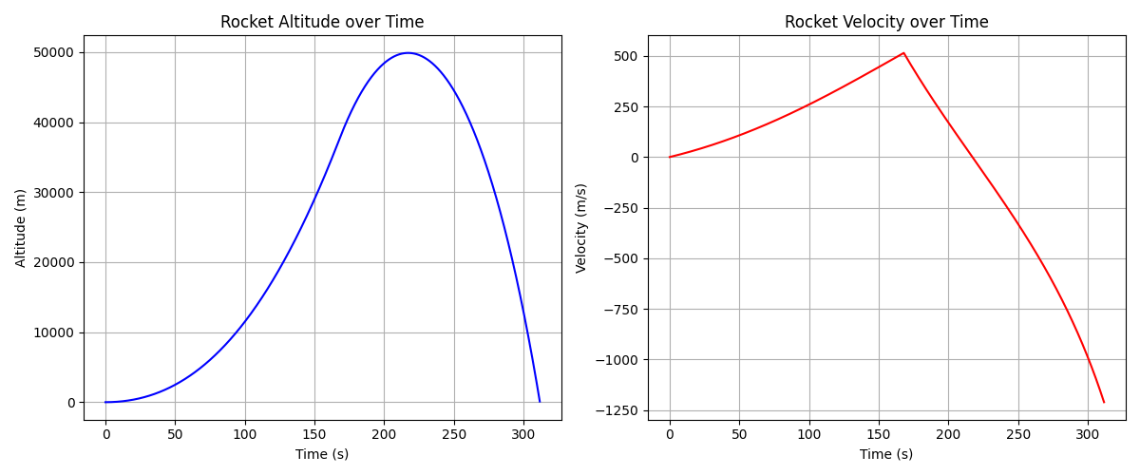
Preliminary Testing Results
Apogee Diamondback Model Rocket with Estes A8 Engine
Saturn V Rocket with Rocketdyne F-1 Engine
Doesn’t accurately simulate spaceflight
More realistic use case once boundary conditions are added
Matches output from an online simulator
Not enough time in air to test other parameters

Slide 5
Next Steps
Create functions to more accurately describe thrust and air density
Use OOP approach and separate rocket functionality from simulator functionality
Implement boundary conditions for simulation stoppage (example: exiting earth’s atmosphere)
Create a simple pyQt GUI to allow users to input parameters and see output results

